Slide 1


SAP BTP CPI Training

Slide 2

DISCLAIMER
The training content and delivery of this presentation is confidential, and cannot be recorded, or copied and distributed to any third party, without the written consent of Anubhav Trainings

Slide 3


Introduction

Slide 4
Agenda
Mapping
Converter
Live example of Converter using POSTMAN

Slide 5
Adapters
Connects SAP Cloud Integration to Sender or Receiver
HTTPS:
Establishes an HTTPS connection between SAP Cloud Integration and a sender system.

Slide 6
HTTP ADAPTER
Parameters of the HTTPS Sender Adapter
Parameter | Description
Address | Enter the URL of the HTTP system to connect to.
Authorization | Specifies the authorization option for the sender.
CSRF Protected | This option prevents Cross-Site Request Forgery (CSRF), which is a malicious online attack. Such attacks exposes user content without their authorization.
CamelHttpUrl
Refers to the complete URL called, without query parameters.
For example, CamelHttpUrl=https://test.bsn.neo.ondemand.com/http/hello.

Slide 7
Postman CPI Integration
Postman
CPI

Slide 8
POSTMAN CPI integration
Things required
End point URL
CPI User id and password

Slide 9
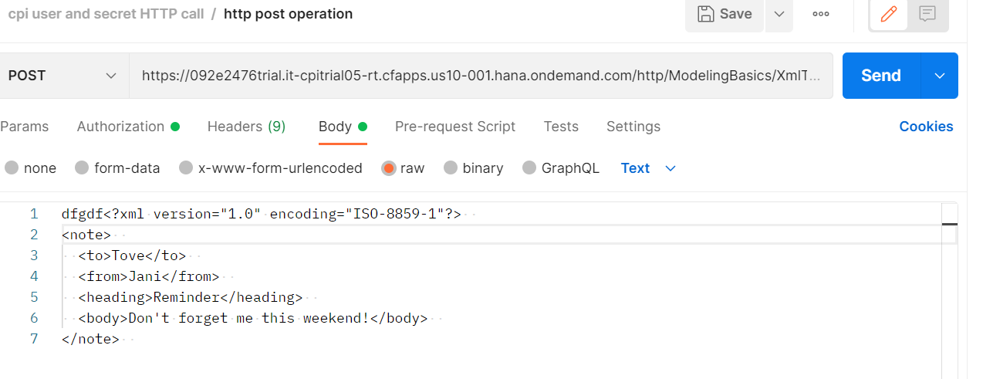
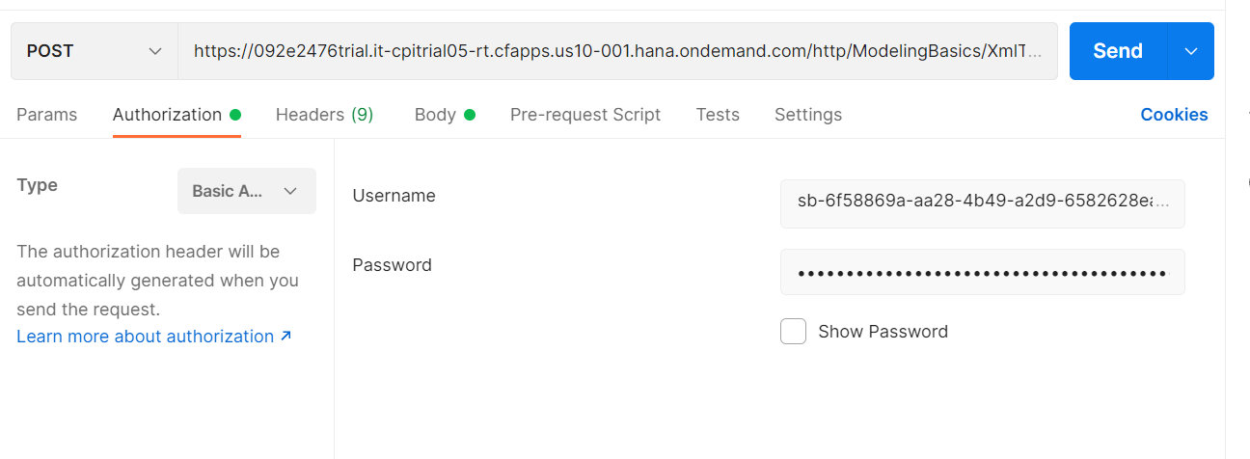
POSTMAN CPI INtegration

Slide 10
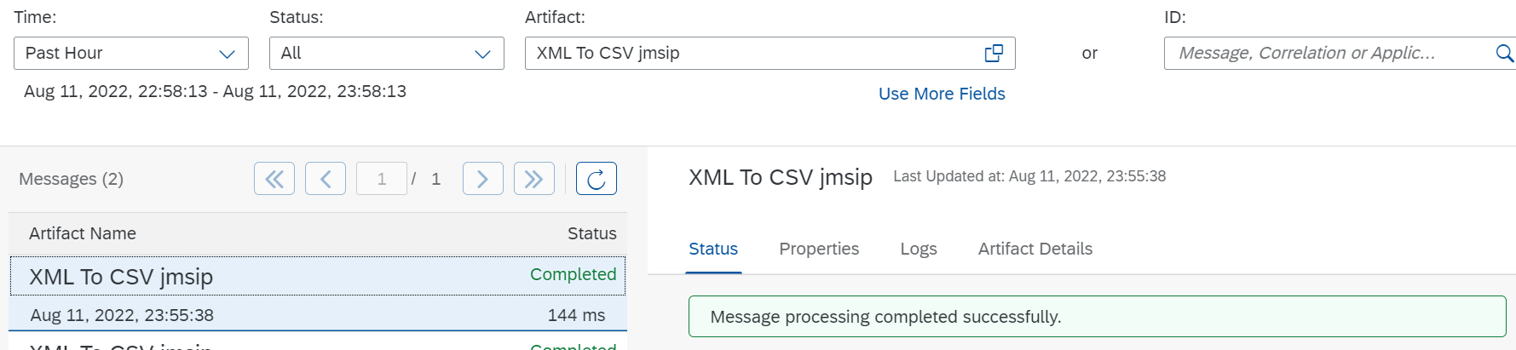
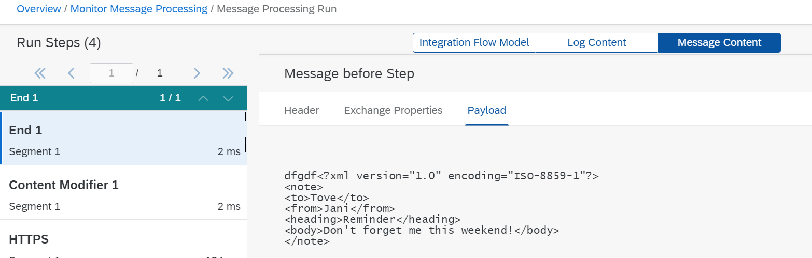
POSTMAN CPI INtegration

Slide 11
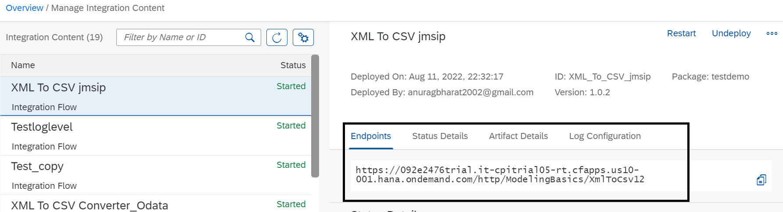
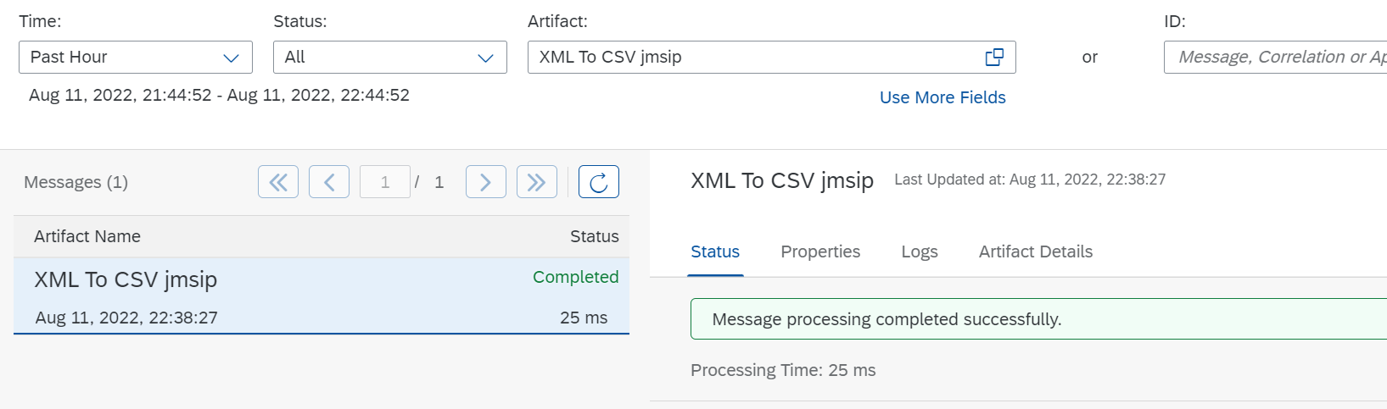
POSTMAN CPI Integration

Slide 12
CSV to XML Converter
Procedure
In the palette, choose , then navigate to Converter CSV to XML Converter.
Place the CSV to XML converter shape in the integration process and define the message path.

Slide 13
Choose CSV to XML Converter and provide values in fields based on description in table.

Slide 14
Field | Description
XML Schema | Choose Browse. Select the XML schema you want to use. Optionally, you can also upload the XML schema from your local file system by choosing Upload from File System.
Path to Target Element in XSD | XPath in the XML schema file where you want to place the content from CSV file.
Record Marker in CSV | The record in CSV file that indicates the entry that the converter has to consider as the starting point of the content. Note If you don’t provide a value for this field, the converter considers all the records in the CSV file for conversion.
Field Separator in CSV | Select the character from dropdown list that is used as the field separator in CSV file. Tip If you want to use a field separator that isn’t available in the dropdown list, manually enter the character.
Exclude First Line Header | Select this checkbox if you want to use the header information from the first line of CSV file to map the column to the corresponding xsd attributes.Note If you don't select the checkbox, then the converter maps the attributes of the CSV file to the order of occurrence in the XSD. To use this option, the CSV and XSD must share the same header-attribute names. If the header names don't match or the same header name is used multiple times in the first line of the CSV, it leads to ambiguity that the converter can resolve as it's an unsupported XML specification.
Choose CSV to XML Converter and provide values in fields based on description in table

Slide 16
Schema
<?xml version="1.0" encoding="UTF-8" standalone="yes"?><xs:schema attributeFormDefault="unqualified" elementFormDefault="qualified" xmlns:xs="http://www.w3.org/2001/XMLSchema"> <xs:element name="Products"> <xs:complexType> <xs:sequence> <xs:element minOccurs="1" maxOccurs="unbounded" name="Product"> <xs:complexType> <xs:sequence> <xs:element nillable="false" maxOccurs="1" name="ProductId"> <xs:simpleType> <xs:restriction base="xs:string" xmlns=""> <xs:maxLength value="10"/> </xs:restriction> </xs:simpleType> </xs:element> <xs:element type="xs:string" nillable="true" minOccurs="0" maxOccurs="1" name="Name" xmlns=""/> <xs:element nillable="true" minOccurs="0" maxOccurs="1" name="Category"> <xs:simpleType> <xs:restriction base="xs:string" xmlns=""> <xs:maxLength value="40"/> </xs:restriction> </xs:simpleType> </xs:element> <xs:element nillable="true" minOccurs="0" maxOccurs="1" name="DimensionUnit"> <xs:simpleType> <xs:restriction base="xs:string" xmlns=""> <xs:maxLength value="3"/> </xs:restriction> </xs:simpleType> </xs:element> <xs:element type="xs:decimal" nillable="true" minOccurs="0" maxOccurs="1" name="DimensionDepth" xmlns=""/> <xs:element type="xs:decimal" nillable="true" minOccurs="0" maxOccurs="1" name="DimensionHeight" xmlns=""/> <xs:element type="xs:decimal" nillable="true" minOccurs="0" maxOccurs="1" name="DimensionWidth" xmlns=""/> <xs:element type="xs:decimal" nillable="true" minOccurs="0" maxOccurs="1" name="Weight" xmlns=""/> <xs:element nillable="true" minOccurs="0" maxOccurs="1" name="WeightUnit"> <xs:simpleType> <xs:restriction base="xs:string" xmlns=""> <xs:maxLength value="3"/> </xs:restriction> </xs:simpleType> </xs:element> </xs:sequence> </xs:complexType> </xs:element> </xs:sequence> </xs:complexType> </xs:element></xs:schema>

Slide 20
XML to CSV Converter
Procedure
In the palette, choose , then Converter XML to CSV Converter.
Place the XML to CSV converter in the integration process and define the message path.

Slide 21
Field | Description
Path to Source Element in XSD | Path to the source element in the XSD file
Field Separator in CSV | Select the character that you want to use as the field separator in CSV file from dropdown list Tip If you want to use a field separator that is not available in the dropdown list, manually enter the character.
Include Field Name as Headers | Select this checkbox if you want to use the field names as the headers in CSV file
Include Parent Element | Select this checkbox if you want to include the parent element of the XML file in CSV file
Include Attribute Values | Select this checkbox if you want to include attribute values in the CSV file
Choose XML to CSV Converter and provide values in fields based on description in table

Slide 22
Json to XML converter
The JSON to XML converter enables you to transform messages in JSON format to XML format.
Procedure
In the palette, choose , then choose Transformation Converter JSON to XML Converter.
Insert the converter at the desired position in your integration process. The converter appears as a graphical element in your integration process.
The properties tab page for the XML to JSON Converter opens.

Slide 23
Json to XML converter
Tab | Option | Description
General | Name | Enter the name of the converter.
Processing | JSON Prefix (only if the option Use Namespace Mapping is selected) | Enter the mapping of the JSON prefix to the XML namespace. The JSON namespace/prefix must begin with a letter and can contain aA-zZ and 0-9.
 | JSON Prefix Separator | Enter the JSON prefix separator to be used to separate the JSON prefix from the local part. The value used must not be used in the JSON prefix or local name. The following characters are allowed: colon(:), comma(,), dot(.), pipe(|), semicolon(;), and space.
 | Add XML Root Element | Select this option to convert JSON documents with an XML root element
 | Name (only if the option Add XML Root Element is selected) | Enter the name of the XML root element. The name must comply with the NCName rules: The name must begin with a letter or an underscore. The valid characters for the remainder of the name are: Letters Digits Period Hyphen Underscore
 | Namespace Mapping (only if the option Add XML Root Element is selected) | Enter the namespace of the XML root element that you have configured in the integration flow.
Define the parameters for your conversion, see table below

Slide 24
XML to JSON Converter
Procedure
In the palette, choose  Transformation Converter XML to JSON Converter.Your cusor symbol
Insert the converter at the desired position in your integration process.The converter appears as a graphical element in your integration process.
The properties tab page for the XML to JSON-Converter opens

Slide 25
Option | Description
Name | Enter the name of the converter.
JSON Output Encoding | Enter the JSON output encoding. The default value is from header or property. If you select from header or property, the converter tries to read the encoding from the message header or exchange property CamelCharsetName. If there is no value defined, UTF-8 is used.
XML Namespace (only if the option Namespace Mapping is selected) | If you select from header or property, the converter tries to read the encoding from the message header or exchange property CamelCharsetName. If there is no value defined, UTF-8 is used.
JSON Prefix Separator (only if the option Namespace Mapping is selected) | Enter the JSON prefix separator to be used to separate the JSON prefix from the local part. The value used must not be used in the JSON prefix or local name. The following characters are allowed: colon(:), comma(,), dot(.), pipe(|), semicolon(;), and space.
Suppress JSON Root Element | Choose this option to create the JSON message without the root element tag.
Define the parameters for your conversion, see table below

Slide 26
Message Mapping
Message Mapping is nothing but a set of rules for producing target XML from the source XML.
These rules are nothing but relations between the source XML tags and target XML tags”
For example, consider the record Employee and we need to update the employee identification number. In the sender system, the field name is Employee ID. However, in the receiver system, the same field is called ID.

Slide 27
Source Field | Target Field
Employee | User
Employee ID | ID
Employee Name | Name
Employee Surname | LastName
Date of Birth | DOB

Slide 28
Use
You use message mapping, to define an association between fields of messages with different structuring. This enables the Cloud Integration system to recognize and update the relevant fields in the target systems.

Slide 30
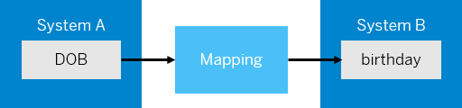
Standard and Custom Mapping Functions
In the same scenario, let us assume that the date of birth in system A is in YYYY-MM-DD format. You want to change the format to DD-MM-YYYY, the format in system B. In this case, you can use a mapping function that transforms the data into the format that you want, which in this case is DD-MM-YYYY.

Slide 31
The mapping editor provides some standard functions like Arithmetic, Boolean, Constants, Conversions, and Date.
If you're unable to achieve the desired transformation using standard functions, you can create a custom function in one of the following ways.Choose  (create script) to create a custom-mapping function by manually entering the script.
Choose  (add script file) to upload a script file that contains the custom-mapping function.

Slide 32
Testing Message Mapping
The mapping editor provides 2 ways of testing message mapping:Simulate – for testing the entire mapping XML.
Display Queue – for testing a specific node of the XML.

Slide 33
Testing Message Mapping
The mapping editor provides 2 ways of testing message mapping:Simulate – for testing the entire mapping XML.
Display Queue – for testing a specific node of the XML.

Slide 34
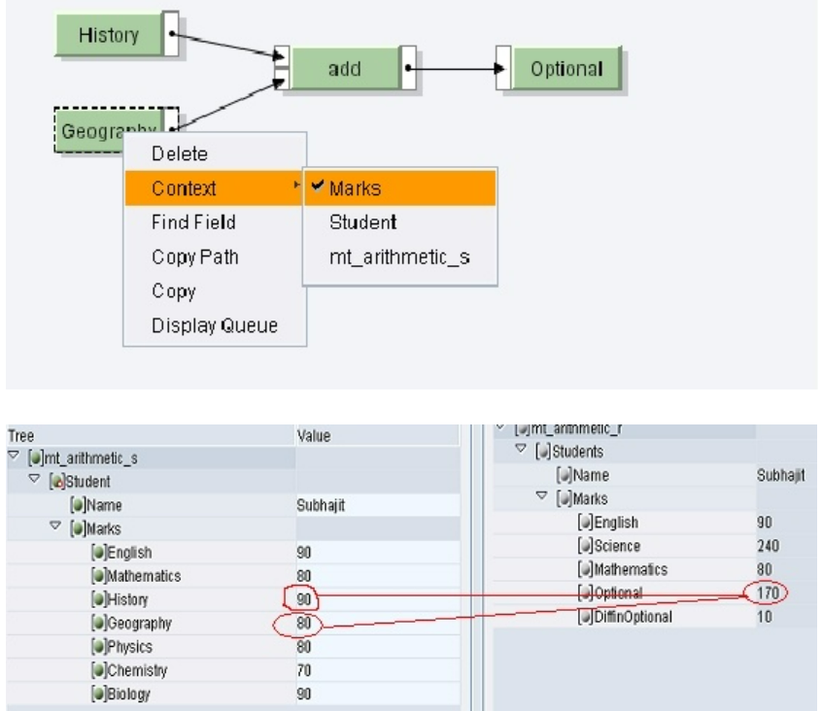
Mapping
Add

Slide 35
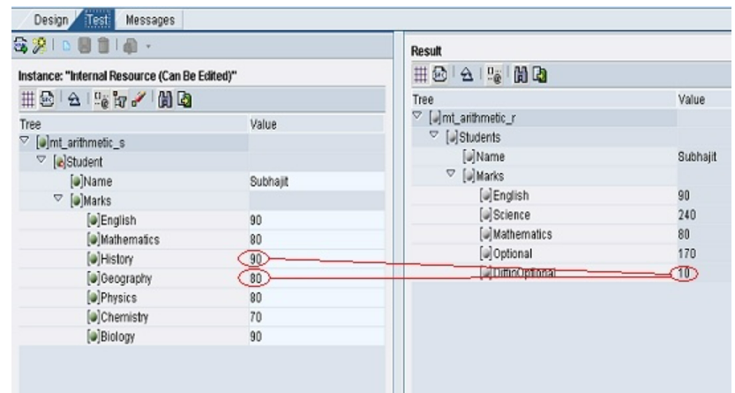
Mapping
Substract

Slide 36
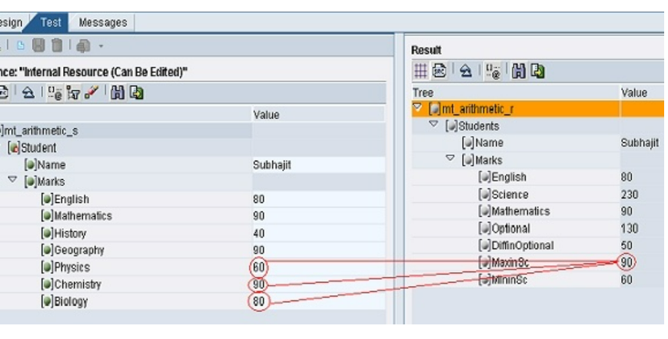
Max and MIn

Slide 37
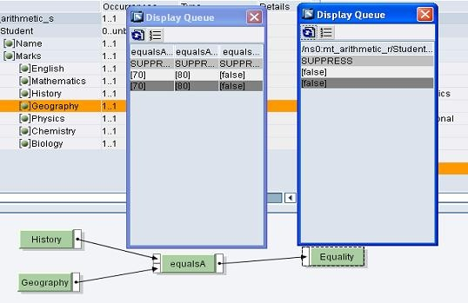
equalsA: This function takes the two float inputs, compares them and returns 'true' if the values are equal else 'false'.

Slide 38
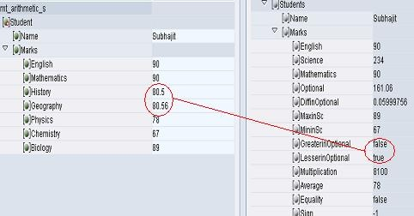
greater: This function takes two input values and compares them. If the first value is greater than the second one, the output is 'true' else 'false'. less: This function takes two input values and compares them. If the first value is less than the second one, the output is 'true' else 'false'.

Slide 39
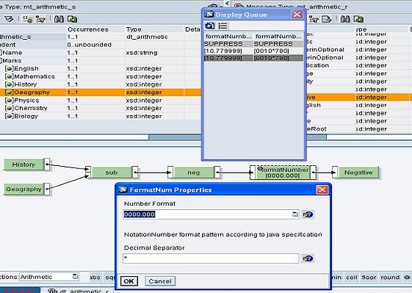
FormatNum: This standard function helps in displaying the result in the required format

Slide 40
Constants:
The standard functions of the Constants function category do not have an input value. Therefore, they generate a value for a target field instead of taking it from a source field. . In addition to these functions, all functions (regardless of whether they are standard or user-defined functions) that do not have input values are referred to as Generating Functions.
CONSTANT: O gets any string constant that you can enter in the dialog for the function properties.

Slide 41
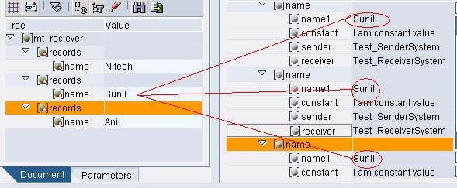
Mapping
Copy Value

Slide 42
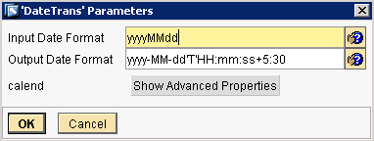
Mapping
Date Functions
Date and time functions are scalar functions that perform an operation on a date and time input value and returns either a string, numeric, or date and time value.

Slide 43
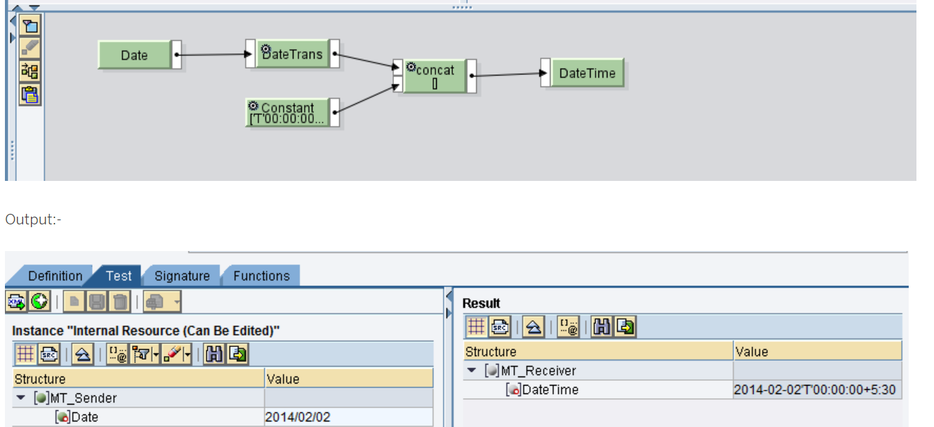
concatenate

Slide 44
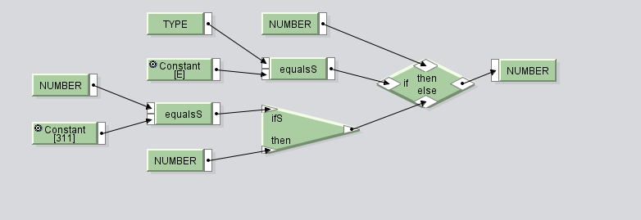
If else condition

Slide 45
Mapping Function
equalsS Function available in Text Function
R = true, if string X equals string Y, otherwise R = false

Slide 46
If Else
If without else
And
Or

Slide 47
Context
XML messages in CPI are handled as Queues. In a queue, Context is the position or the level of a XML node (element) relative to a parent node. If elements belong to the same parent node, the elements are in same Context. When the parent node changes, Context Change is inserted to the queue. Context Changes are shown in dark gray color

Slide 48
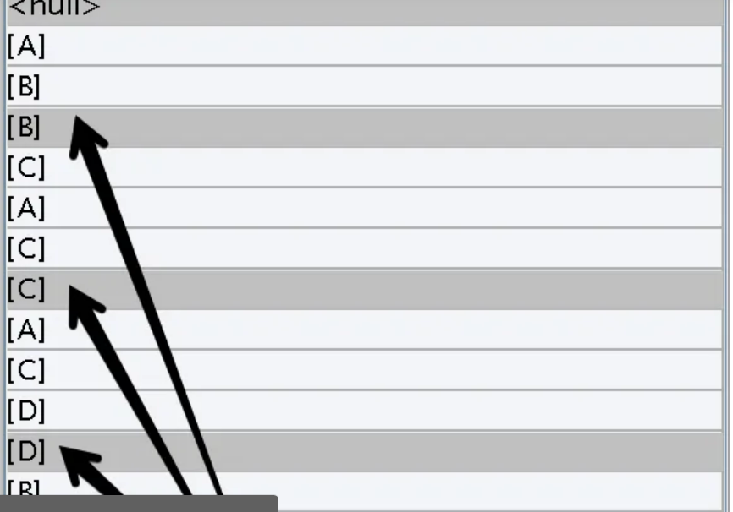

Slide 50
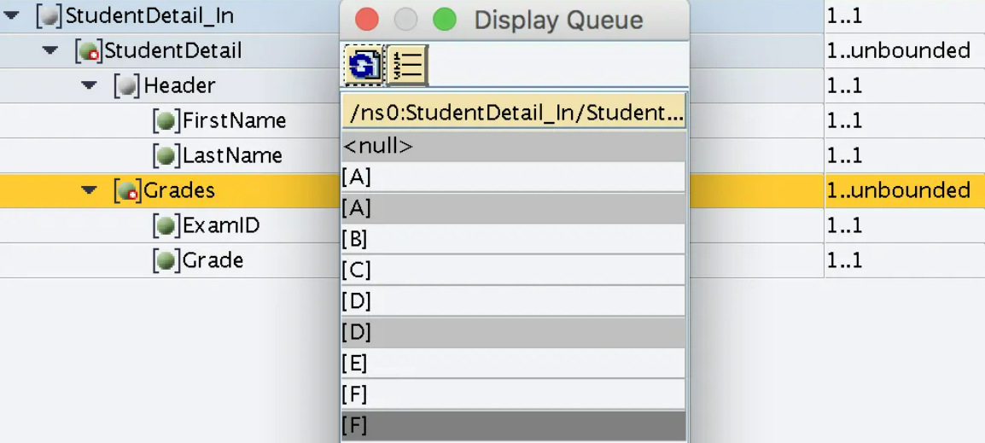

Slide 51
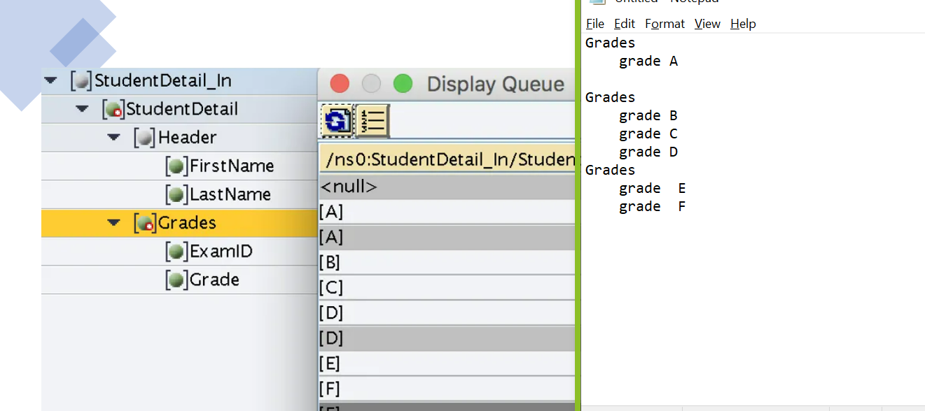

Slide 54
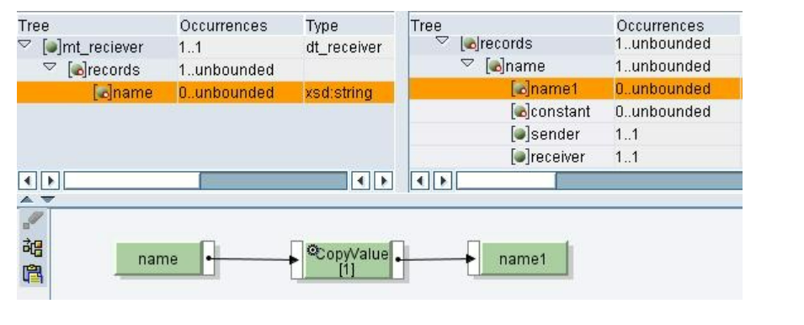
Copy value

Slide 55
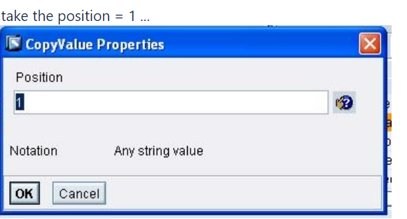

Slide 56
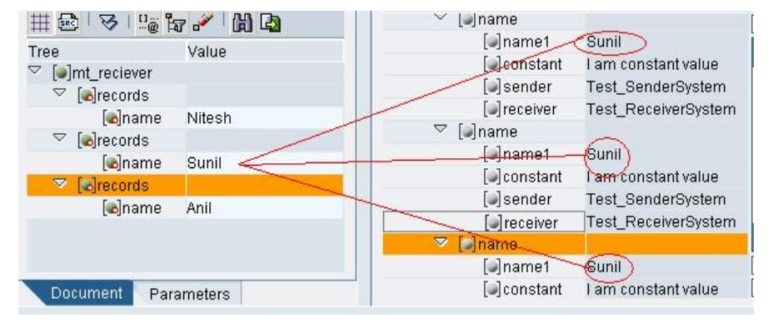

Slide 57
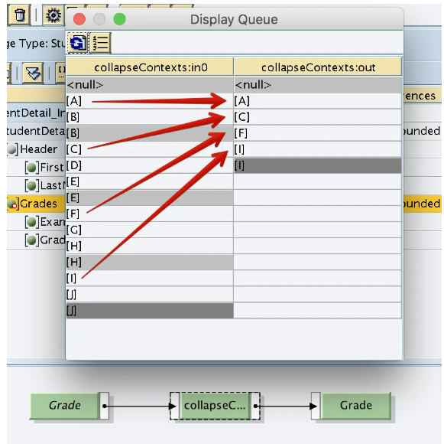
Collpase context

Slide 58
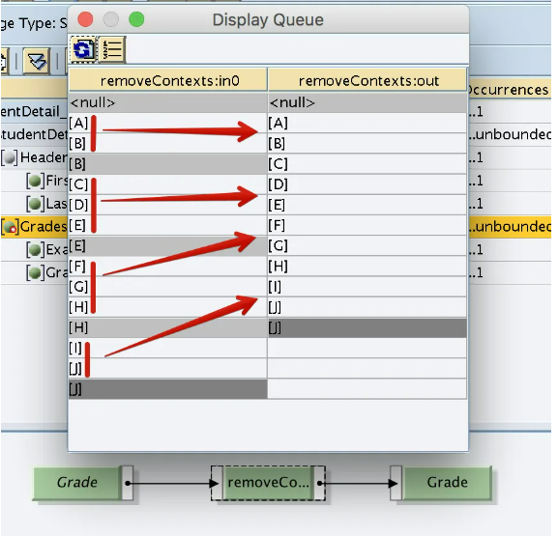
Remove context

Slide 59
Node function

Slide 60
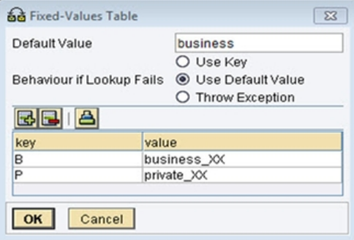
Mapping
FixValues
FixValues is a standard function of the Conversions function group; it enables fixed value pairs to be saved in a message mapping
this function generally used for fixed value transfermations during message mapping based on key values.

Slide 61
Remove context

Slide 63
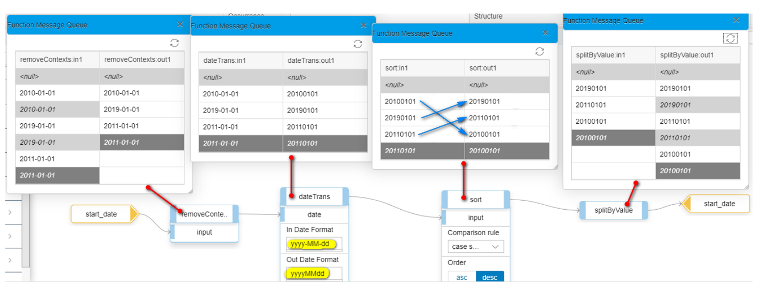
Sort Function
Sort simply sorts an array in ascending or descending order, depending on your choice. SortByKey arranges one array on the sorting order of another array

Slide 64

Summarize
LET’S SUMMARISE!

Slide 65

Summarize
End of Day 1

Slide 67


We’re committed to empower you to be
#FutureReady
through powerful training solutions.
We build the workforce of the future.
250+
Corporate Clients
30,000+
Learners Trained
25000+
Learners Placed
FREE WEBINARS
Sign up for free webinars with industry experts every fortnight!
Enroll Now!
Contact us today!
https://anubhavtrainings.com

